Slide 1

USED CAR DEALERSHIP 2014
System design and analysis By: Michael Bowen, Tyler Chess, Doreen Esposito, Derek Fawcett, Antonio gunter, Joshua Ibrahim, Barbara McGee, Scott McWilliams, John Smith, Joseph Yablinsky

Slide 2
Project Objective
Enable company to quickly and accurately maintain and access business data
sales
inventory
payroll
customers
work done by mechanics
Lay the groundwork for the expansion of the business into further locations and web based sales

Slide 3
Information Technology Project Management
Expected Time Calculation Chart
Shows the optimistic, realistic, and pessimistic estimates for each activity
Calculates the expected completion times for each activity using the formula
[o + 4(r) + p / 6] which is then entered into the Gantt Chart
Gantt Chart
Shows each task as a horizontal bar whose length is proportional to its time for completion
Network Diagram
Shows the project tasks and their interrelationships

Slide 4
Expected Time Calculation Chart
 |  | Time Estimate |  |  | Expected Time (ET)
 |  |  | (in days) |  | o+4(r)+p
 | Activity | o | r | p | 6
 | 1. Research Hardware and Software | 10 | 14 | 18 | 14
 | 2. Build Cloud Based Model | 5 | 7 | 9 | 7
 | 3. Design Website | 6 | 7 | 8 | 7
 | 4. Integrate Cloud and Website | 12 | 13 | 20 | 14
 | 5. Test | 8 | 15 | 16 | 14
 | 6. Train Employees | 10 | 14 | 18 | 14

Slide 5
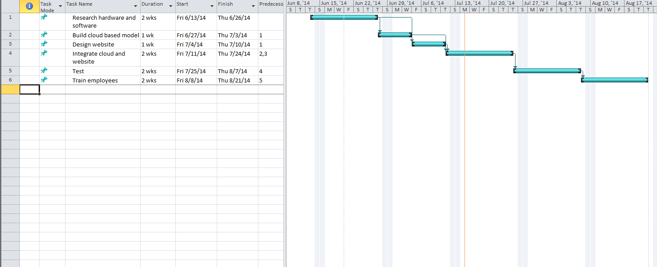
GANTT Chart

Slide 6
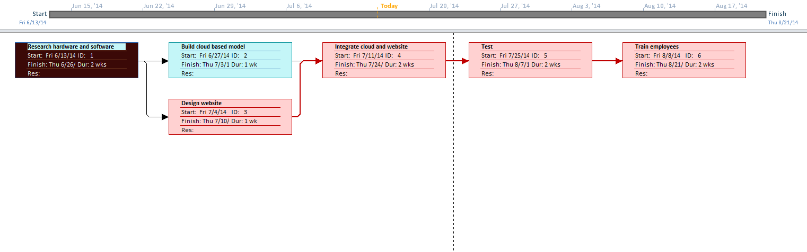
Network Diagram

Slide 7
Microsoft Azure Assessment
Platform as a Service(PaaS) Infrastructure
Cloud Computing
Cut costs
No additional equipment
Azure all in one PaaS, offers Virtual Desktop Network service, Website Hosting, Virtual Network, SQL Database, & an ISP
Can meet growth requirements with this model
Fits our needs with an SQL Server, website storage, 5 computers running virtual machines for current employees, 10 computers for new employees running Azure Virtual Machine, 300gb a month
$2582/Month on 12 month plan, .20 cent per hour increase for each additional computer
Needs someone to design a website and design our database schema. Integration of database to website is $12,260

Slide 8
Data Flow Diagram (DFD)
Allows analyst to model how data will flow through a proposed system
Consists of four main parts
Data flows
Data stores
Processes
Sources and Sinks
Represents a conceptual version of how data is processed by a system through the use of several multi-level diagram depictions known as levels
Enables a greater understanding of the system and its design

Slide 9
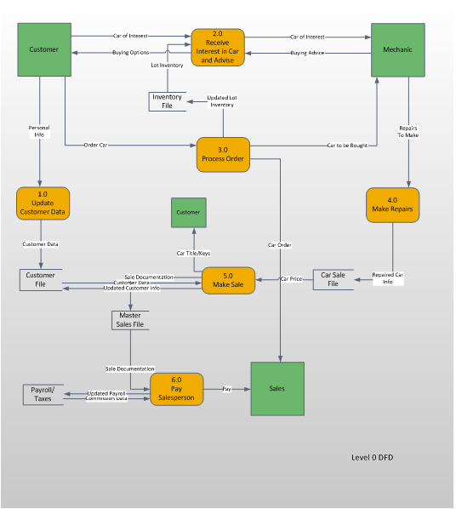
DFD Level - 0

Slide 10
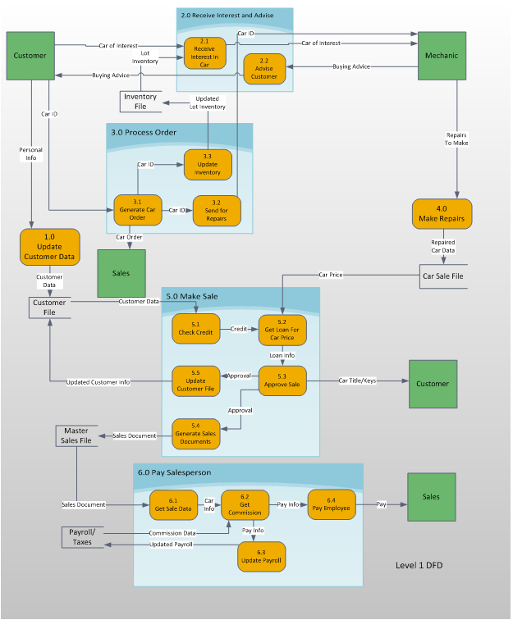
DFD Level - 1

Slide 11
Entity-Relationship Diagram
Tool used by analysts to determine how data in a system relates to other data
Holds a large amount of information in a limited amount of space
Consists of two parts
Entities
Discrete objects that represent the data stored and maintained by a system
Includes people, places, events, or concepts
Relationships
Demonstrates how data is shared between entities

Slide 12
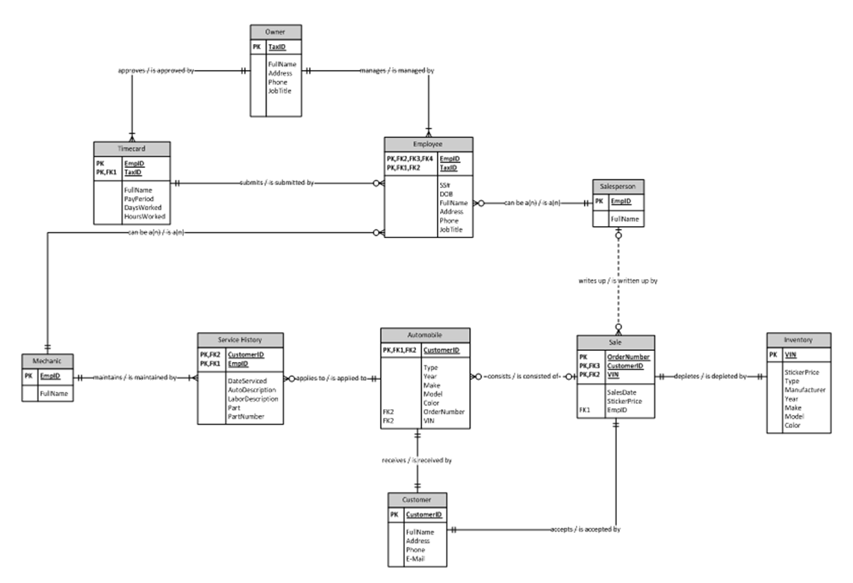
Entity-Relationship Diagram (cont.)

Slide 13
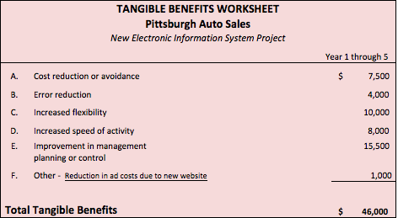
Tangible Benefits
A. Cost reduction or avoidance is the result of less time spent by the bookkeeper and mechanic filling out paper forms and better inventory control. It is estimated that 10% of their time is spent on these activities
B. Error reduction is a result of wasted time correcting data entry errors by the employees
C. Increased flexibility will result from faster organization of data and the use of that data
D. Faster access to data will reduce costs through increased speed of most activities
E. The owner will benefit from better analysis resulting in improved management and control
F. The new website will result in lower advertising costs

Slide 14
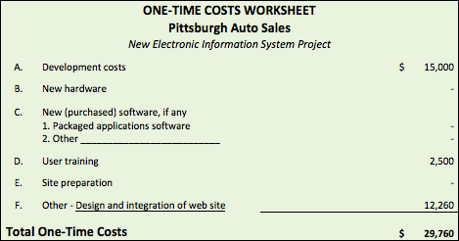
One-Time Costs
A. Development costs consist of the costs incurred by the Summer 2014 CIT 215 Development Group to develop the Pittsburgh Auto Sales network
D. User training costs are costs associated with training provided by the Summer 2014 CIT 215 Development Group
F. Other costs include website development

Slide 15
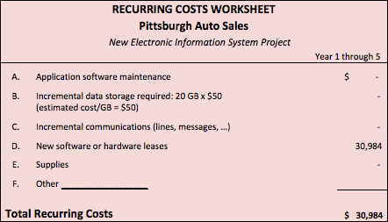
Recurring Costs
D. New software and hardware leases are for the Windows Azure platform

Slide 16
Present Value Calculations

Slide 17
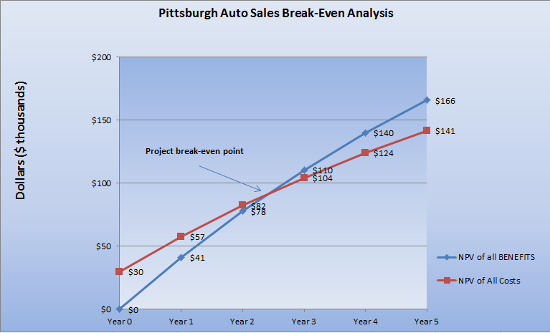
Break-Even Analysis

Slide 18
Criteria/Weighted Approach Tables
Represents a measured approach to comparing multiple solutions for fulfilling system requirements
Criteria
Consists of requirements and constraints
Describes proposed solution requirements necessary to fulfill system expectations and the limits imposed upon acquiring and maintaining those solutions
Weighted Approach Tables
Assigns numerical weights to requirements and constraints to calculate scores for each proposed solution
Total scores can be compared to determine the best alternative solution

Slide 19
Smartphones

Slide 20
Smartphones (cont.)

Slide 21
Tablets

Slide 22
Tablets (cont.)
Criteria | Weight | IPAD AIR |  | Amazon Kindle Fire HDX 7
 |  | Rating | Score | Rating | Score
Requirements
Real time database/system access | 20 | 4 | 80 | 4 | 80
Picture and video support | 10 | 3 | 30 | 5 | 50
Battery Life | 5 | 5 | 25 | 4 | 20
Display inventory data | 15 | 3 | 45 | 5 | 75
 | 50 |  | 180 |  | 225
Constraints
Development cost | 20 | 3 | 60 | 4 | 80
Hardware cost | 15 | 4 | 60 | 4 | 60
Time to operation | 10 | 5 | 50 | 5 | 50
Ease of training | 5 | 5 | 25 | 5 | 25
 | 50 |  | 195 |  | 215
Total | 100 |  | 205 |  | 250

Slide 23
Antivirus
Criteria:
 | Kaspersky | Norton | McAfee
Requirements
Ability to schedule scans | Yes | Yes | Yes
Automatic scans | Yes | Yes | Yes
Up to date detection | Yes | Yes | Yes
Proven ability to prevent and remove viruses, malware, worms, etc. | High | Medium | Low
Constraints
Cost of software | 59.95 / year | 49.99 / year | $34.99
Cost of service subscription | Free | Same | Same
Tax on system hardware during scans | Reduced when memory low | Low | Medium

Slide 24
Antivirus (cont.)

Slide 25
Firewall

Slide 26
Firewall (cont.)

Slide 27
Firewall (cont.)

Slide 28
Input Form Design
Vehicle Service Update
Allows user to create/update vehicle service history
Top portion - Vehicle Information
User enters VIN
Additional fields auto-populate
Bottom portion – Service Update
User enters service-specific information
Mechanic Name/Location auto-populates based upon completed Mechanic ID field
Total Cost auto-populates based upon completed Parts Cost/Labor Cost fields

Slide 29
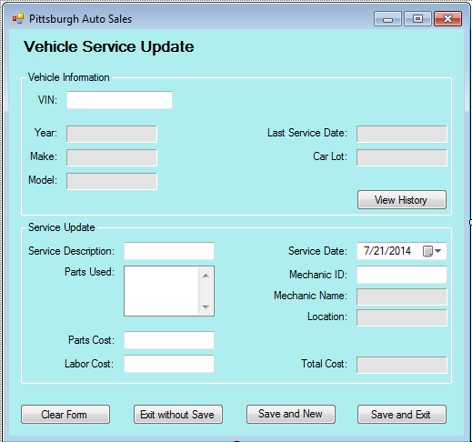
Input Form Design (cont.)

Slide 30
Output Report Design
Generated by Order Number
Includes four pertinent areas of summary data
Vehicle information
Customer information
Employee information
Financial Information
Owner prints, signs, and stores as permanent hard-copy record of approved sale

Slide 31
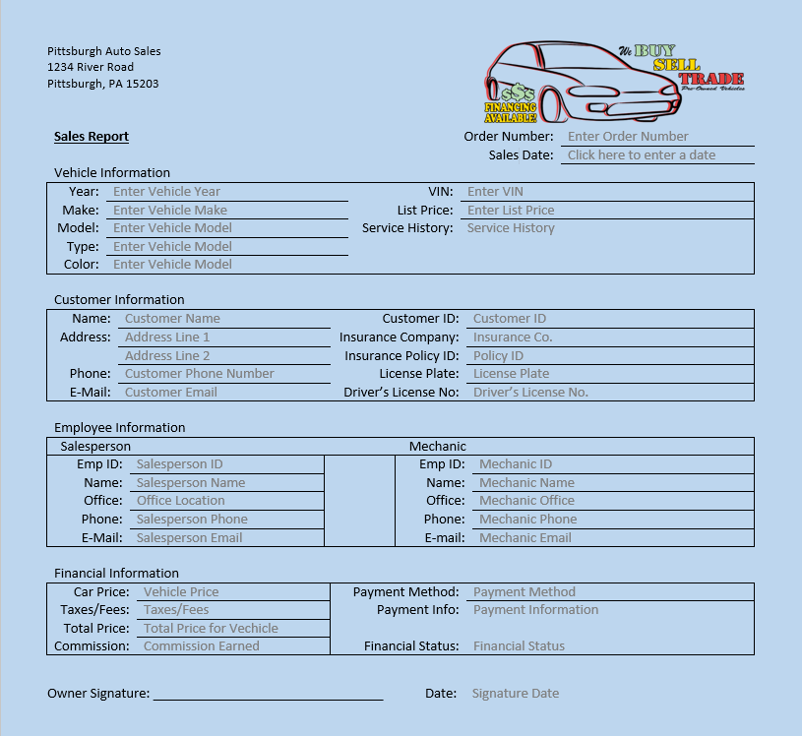
Output Report Design (cont.)

Slide 32
Database Table Design
Represents various areas of object data that will be tracked and stored by the information system
Data may include
Unique vehicle information
Service history information
Customer information
Employee information

Slide 33
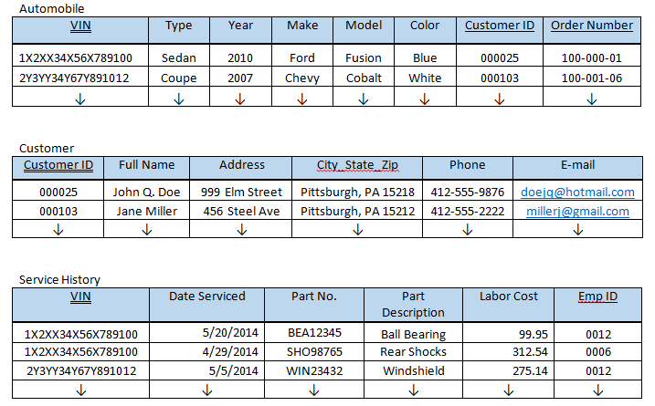
Database Table Design (cont.)

Slide 34
System Implementation and Operation
Final phase of Systems Development Life Cycle (SDLC)
Includes seven major activities
Coding
Testing
Installation
Documentation
Training
Support
Maintenance

Slide 35
Overall Summary and Recommendations
Summary
Summer 2014 CIT 215 Development Group report outlines in detail the planning, analysis, design, and implementation of proposed computerized system
Addresses all needs not met by current paper system utilized by company
Recommendations
Microsoft Azure cloud-based system
iPhone 5 smartphone
iPad Air tablet
Panda Cloud firewall
Kaspersky antivirus software

